Slide 1
Dynamic Routing Between Capsules Sara Sabour, Nicholas Frosst, Geoffrey E Hinton
Yangqi Su

Slide 2
Purpose and Background
Convolutional Neural Networks are not robust in the prediction of rotated images and do not fully take into account object orientation and spatial relationships.
Face Face Not Face

Slide 3
Problem?
Max pooling:
Helps higher layers increase field of view, but also loses important information
Internal Representation:
The internal representation of a image in a CNN does not fully take into account spatial relationships of different patterns in a image.
Scalar representations of objects in a image does not tell us how the objects relate to one another.

Slide 4
Hinton’s Solution?
Capsule Theory:
Intuition: Representation of objects in the brain does not depend on view angle
Relationship between objects can be represented as pose (translation and rotation)
Finding a way to preserve hierarchical pose relationship between objects.

Slide 5
Advantages:
Smaller dataset
Translational and rotational invariance
Image Source: https://medium.com/ai%C2%B3-theory-practice-business/understanding-hintons-capsule-networks-part-i-intuition-b4b559d1159b

Slide 6
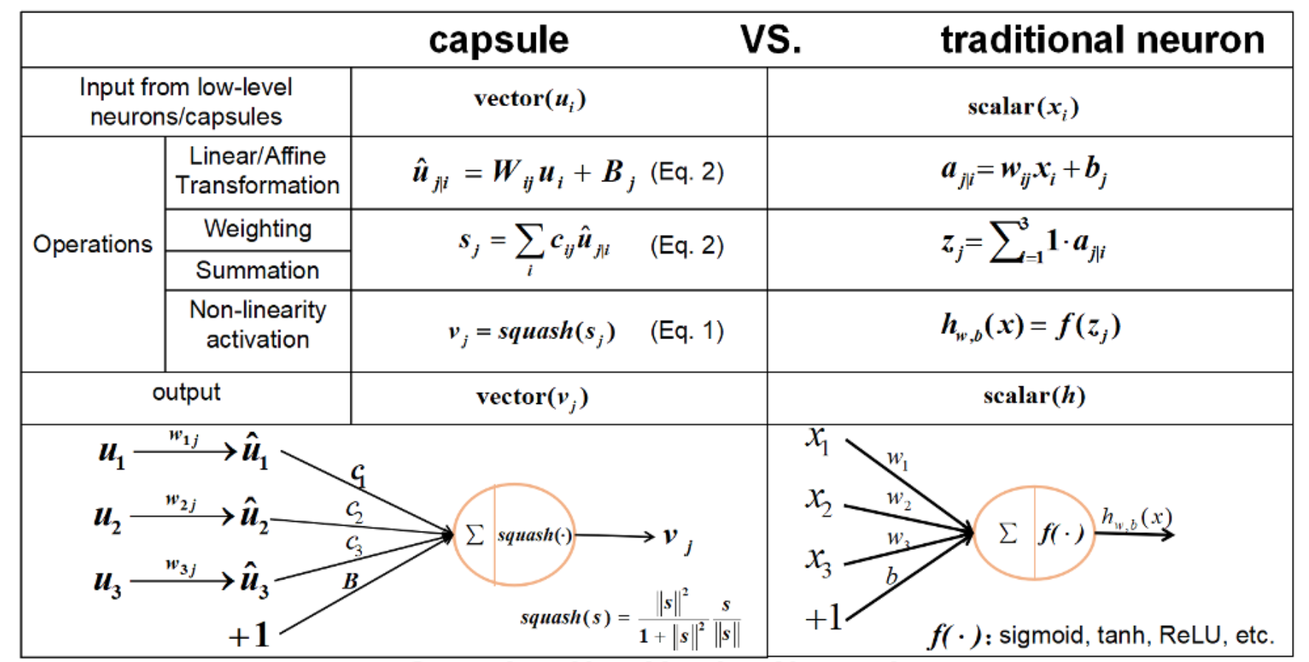
New Functions
Architecture
Basic Units: vectors (or matrices)
Length: ||v|| encodes the existence of an entity
The Squash Function
Image source: https://github.com/naturomics/CapsNet-Tensorflow

Slide 7
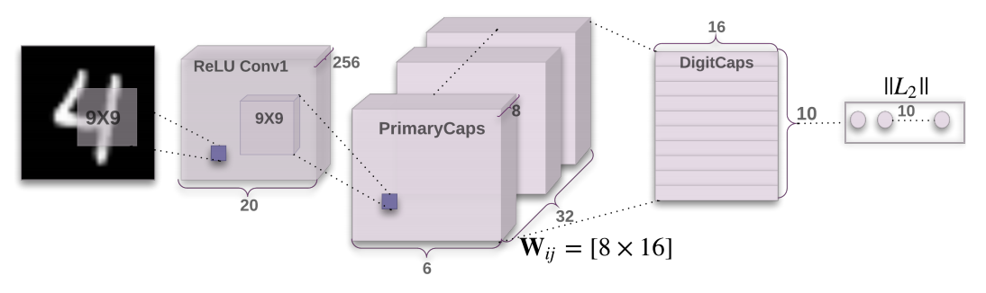
Architecture: ( MINST dataset)
Sara Sabour et al.

Slide 8
Dynamic Routing
Input vector from lower level capsules are affine transformed and weighted summed to form higher level capsule vectors.
Dynamic Routing seeks to learn those weights using Routing by Agreement:
Suppose A, B, C are highly activated capsule vectors representing the pose of different objects and D represent the higher level object composed of A, B, C in some orientation.
Further suppose that after one round of routing, D is highly activated and is the weighted sum of all lower level capsule vectors. If A, B, C’s affine transformed output coincides with the final value of D, then it is likely that D’s existence is more dependent on A, B, C’s existence, thus increasing the “bond” between A, B, C and D.

Slide 9
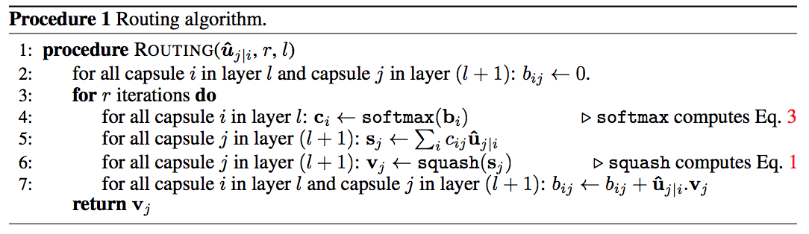
Dynamic Routing (continued)
Sara Sabour et al.

Slide 10
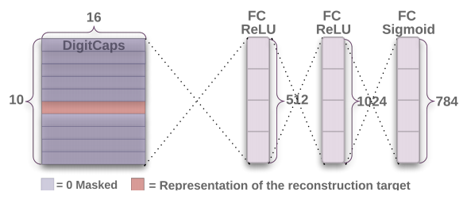
Loss Function and Regularization
Margin Loss Function
Reconstruction Loss as Regularization
Sara Sabour et al.

Slide 11
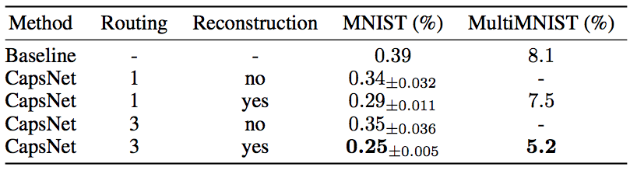
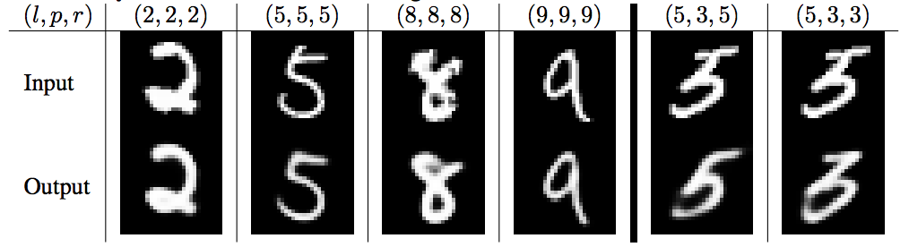
Results
MINST:
Baseline CNN: 34.5M
Caps-Net: 8.2M
Aff-MINST:
Baseline CNN: 66%
Caps-Net: 79%
Sara Sabour et al.

Slide 12
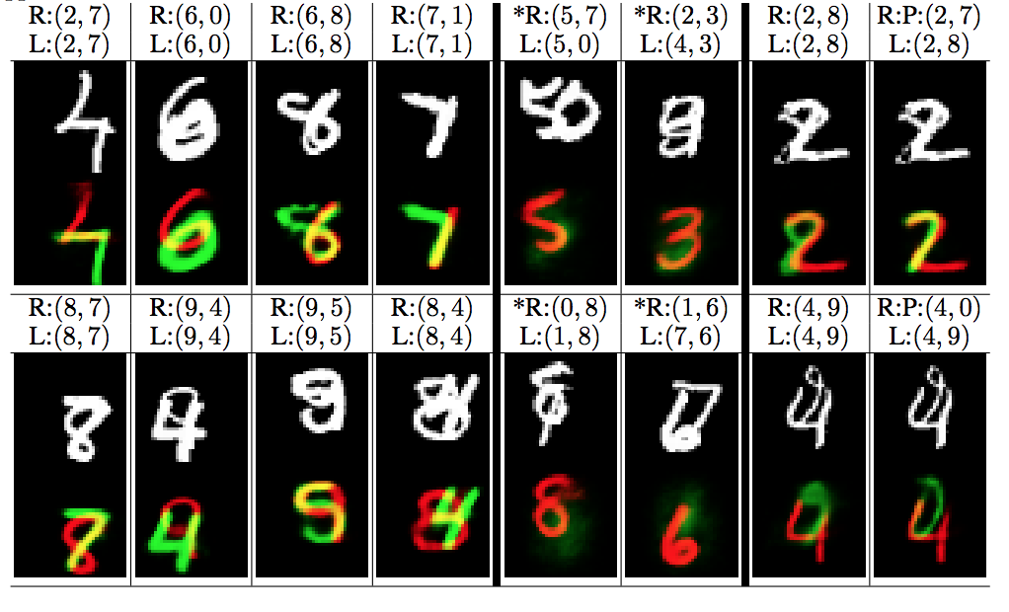
Results
Multi-MINST
5% classification error
60M training
10M testing
80% overlap between digit bounding boxes
Sara Sabour et al.

Slide 13

Results
Small-NORB: 2.6% error rate
state of the art
32x32 greyscale images
CIFAR10: 10.6% error rate
Reasons for poor performance due to diversity of background in images that the CapsNet attempts to model, need reasonably larger network to work

Slide 14
Other work
Matrix Capsules with EM Routing, 2018, Geoffrey Hinton, Sara Sabour, Nicholas Frosst
Uses Matrices as representation of Capsules
Uses a modified version of EM algorithm for routing

Slide 15
References
Sara Sabour, Nicholas Frosst, Geoffrey E Hinton, Dynamic Routing Between Capsules, 2017

Slide 16
Thank You
Questions?

